Slide 1
100 Great New Books
For Middle Grades
Karen Yingling
Fall 2014

Slide 2
100 Great New Books
For Middle Grades
Incorporating Research-Based Instructional Strategies and Resources to Meet the Needs of Every Learner

Slide 3
100 Great New Books
For Middle Grades
We Need Diverse Books

Slide 4
100 Great New Books
For Middle Grades
“This is a good book. You’ll like it.”
How often do we say this instead of “What would YOU like to read today?”

Slide 5
Mysteries

Slide 6
Fake ID
For readers who like:
Inner city stories
Evil corporations
More YA murder mysteries
A bit of sports

Slide 7
Knightley and Son
For readers who like:
London
On-the-lam books
Investigative mysteries
Series books
(February 2015)

Slide 8
The Book of Bad Things
For readers who like:
Really creepy books
Children in difficult situations
Monsters or ghosts
This author

Slide 9
The Prince of Venice Beach
For readers who like:
Skateboarding
California
Living Rough
Police investigations

Slide 10
Lantern Sam and the Blue Streak Bandits
For readers who like:
Historical fiction
Ohio history (Cedar Point!)
Cats
This author

Slide 11
Mystery on Museum Mile
For readers who like:
New York settings
Police investigations
Art mysteries

Slide 12
Poached
For readers who like:
Goofy mysteries
Animals
Friend Drama

Slide 13
Under the Egg
For readers who like:
Art mysteries
Blue Balliet
Children on own
Holocaust tie-ins
Monuments Men

Slide 14
A Million Ways Home
For readers who like:
Problem novels
Animals
Inner city crime
Foster children

Slide 15
Historical

Slide 16
Just a Drop of Water
For readers who like:
9/11
Florida
Running
Racial Profiling

Slide 17
Manor of Secrets
For readers who like:
Downtown Abby
Romance and Intrigue
Posh lifestyle

Slide 18
Beth’s Story, 1914
For readers who like:
Downtown Abby
Accessible historical fiction
Series
Posh lifestyle

Slide 19
The Winter Horses
For readers who like:
Holocaust stories
Horses
Ukrainian history
Survival stories

Slide 20
Stay Where Are and Then Leave
For readers who like:
World War I homefront
PTSD/Shell Shock
Intrepid children
England

Slide 21
Stay Where Are and Then Leave
For readers who like:
War stories
This author
Battle descriptions
Racial issues

Slide 22
Stay Where Are and Then Leave
For readers who like:
1960s
Investigative mysteries
Small town stories

Slide 23
Stay Where Are and Then Leave
For readers who like:
Freedom Summer
Multiple view points
Nonfiction information mixed in

Slide 24
Stay Where Are and Then Leave
For readers who like:
This series
Short reads
Action/Adventure
Ancient Rome

Slide 25
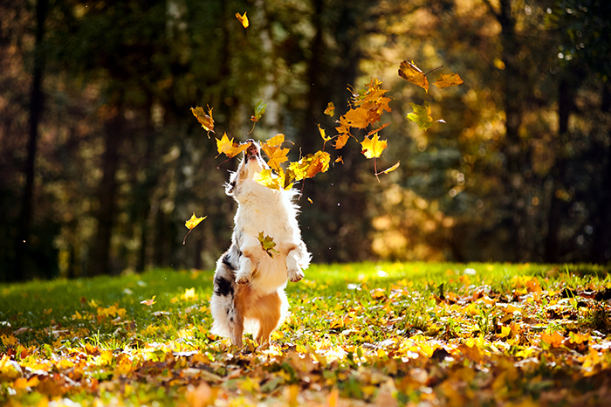
Sports

Slide 26
Stay Where Are and Then Leave
For readers who like:

Slide 27
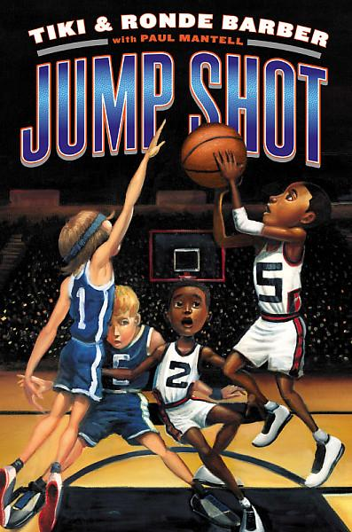
Jump Shot
For readers who like:

Slide 28
Extra Innings
For readers who like:

Slide 29
The Contract
For readers who like:

Slide 30
Fake ID
For readers who like:

Slide 31
Fake ID
For readers who like:

Slide 32
Fake ID
For readers who like:

Slide 33
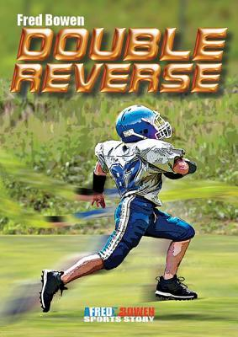
New Kid
For readers who like:

Slide 34
Fake ID
For readers who like:
BL: 4.7 - AR Pts: 2.0

Slide 35
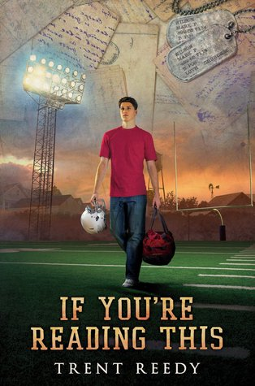
Fake ID
For readers who like:

Slide 36
Speculative

Slide 37
Fake ID
For readers who like:

Slide 38
Fake ID
For readers who like:

Slide 39
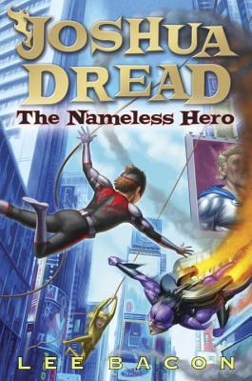
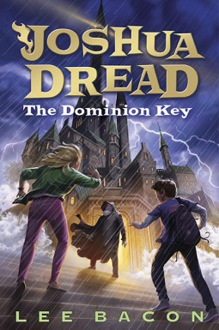
Joshua Dread
For readers who like:

Slide 40
Fake ID
For readers who like:

Slide 41
Fake ID
For readers who like:

Slide 42
Space Case
For readers who like:

Slide 43
Sky Raiders
For readers who like:

Slide 44
Sky Raiders
For readers who like:

Slide 45
No Such Thing As a Witch
For readers who like:
Holocaust stories
Horses
Ukrainian history
Survival stories

Slide 46
Welcome to Dog Beach
For readers who like:
Holocaust stories
Horses
Ukrainian history
Survival stories

Slide 47
Welcome to Dog Beach
For readers who like:
Holocaust stories
Horses
Ukrainian history
Survival stories

Slide 48
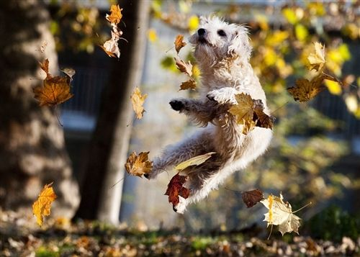
Action/Adventure

Slide 49
Sky Raiders
For readers who like:

Slide 50
Stay Where Are and Then Leave
For readers who like:

Slide 51
Stay Where Are and Then Leave
For readers who like:

Slide 52
Sky Raiders
For readers who like:

Slide 53
Sky Raiders
For readers who like:

Slide 54
Codename Zero
For readers who like:

Slide 55
Sky Raiders
For readers who like:

Slide 56
Fake ID
For readers who like:

Slide 57
Sky Raiders
For readers who like:

Slide 58
Welcome to Dog Beach
For readers who like:
Holocaust stories
Horses
Ukrainian history
Survival stories

Slide 59
Welcome to Dog Beach
For readers who like:
Holocaust stories
Horses
Ukrainian history
Survival stories

Slide 60
Dirt Bikes, Drones, and Other Ways to Fly
For readers who like:
Holocaust stories
Horses
Ukrainian history
Survival stories

Slide 61
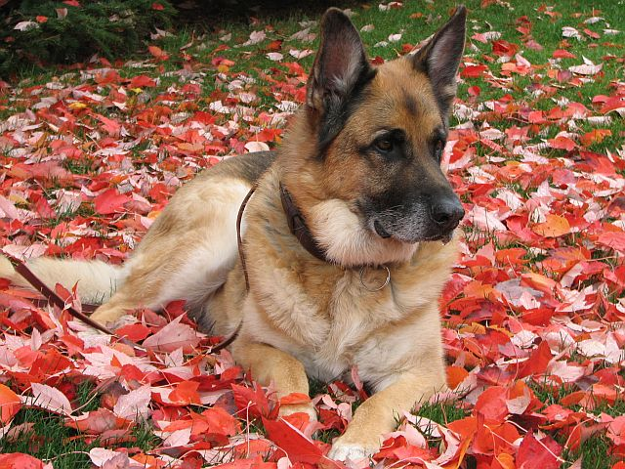
Books for Boys

Slide 62
The Misadventures of the Family Fletcher
For readers who like:

Slide 63
One Man Guy
For readers who like:

Slide 64
Grandmaster
For readers who like:
Chess
Father/Son relationships
Suspense
This author

Slide 65
Three Bird Summer
For readers who like:
Vacation books
Camping
Light Romance
Family Issues

Slide 66
Ginger
For readers who like:

Slide 67
The Life and Times of Benny Alvarez
For readers who like:

Slide 68
Lucky Dog
For readers who like:
Short stories
Dog stories
A variety of authors

Slide 69
Fake ID
For readers who like:

Slide 70
Welcome to Dog Beach
For readers who like:
Holocaust stories
Horses
Ukrainian history
Survival stories

Slide 71
Welcome to Dog Beach
For readers who like:
Holocaust stories
Horses
Ukrainian history
Survival stories

Slide 72
Welcome to Dog Beach
For readers who like:
Holocaust stories
Horses
Ukrainian history
Survival stories

Slide 73
Welcome to Dog Beach
For readers who like:
Holocaust stories
Horses
Ukrainian history
Survival stories

Slide 74
Pure Grit
For readers who like:

Slide 75
Books for Girls

Slide 76
Welcome to Dog Beach
For readers who like:
Holocaust stories
Horses
Ukrainian history
Survival stories

Slide 77
Welcome to Dog Beach
For readers who like:
Holocaust stories
Horses
Ukrainian history
Survival stories

Slide 78
Fake ID
For readers who like:

Slide 79
Welcome to Dog Beach
For readers who like:
Holocaust stories
Horses
Ukrainian history
Survival stories

Slide 80
Fake ID
For readers who like:

Slide 81
Welcome to Dog Beach
For readers who like:
Holocaust stories
Horses
Ukrainian history
Survival stories

Slide 82
Chapel Wars
For readers who like:

Slide 83
Welcome to Dog Beach
For readers who like:
Holocaust stories
Horses
Ukrainian history
Survival stories

Slide 84
Welcome to Dog Beach
For readers who like:
Holocaust stories
Horses
Ukrainian history
Survival stories

Slide 85
Welcome to Dog Beach
For readers who like:
Holocaust stories
Horses
Ukrainian history
Survival stories

Slide 86
Welcome to Dog Beach
For readers who like:
Holocaust stories
Horses
Ukrainian history
Survival stories

Slide 87
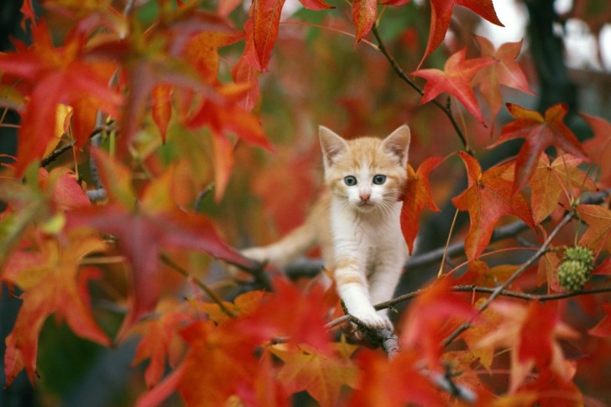
Multicultural

Slide 88
Medal for Leroy
For readers who like:
Holocaust stories
Horses
Ukrainian history
Survival stories

Slide 89
Medal for Leroy
For readers who like:
Holocaust stories
Horses
Ukrainian history
Survival stories

Slide 90
Medal for Leroy
For readers who like:
Holocaust stories
Horses
Ukrainian history
Survival stories

Slide 91
Medal for Leroy
For readers who like:
Holocaust stories
Horses
Ukrainian history
Survival stories

Slide 92
Medal for Leroy
For readers who like:
Holocaust stories
Horses
Ukrainian history
Survival stories

Slide 93
Medal for Leroy
For readers who like:
Holocaust stories
Horses
Ukrainian history
Survival stories

Slide 94
Medal for Leroy
For readers who like:
Holocaust stories
Horses
Ukrainian history
Survival stories

Slide 95
Pure Grit
For readers who like:

Slide 96
Pure Grit
For readers who like:

Slide 97
Pure Grit
For readers who like:

Slide 98
Notebook Novels

Slide 99
Pure Grit
For readers who like:

Slide 100
Pure Grit
For readers who like:

Slide 101
Stick Dog
For readers who like:

Slide 102
Poop Fountain
For readers who like:

Slide 103
Pure Grit
For readers who like:

Slide 104
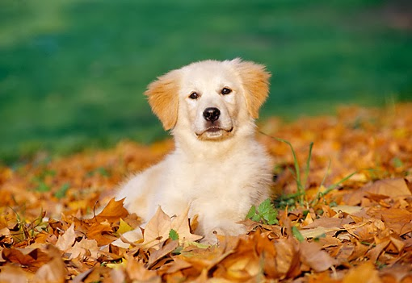
Nonfiction

Slide 105
Pure Grit
For readers who like:

Slide 106
Pure Grit
For readers who like:

Slide 107
Pure Grit
For readers who like:

Slide 108
Pure Grit
For readers who like:

Slide 109
Pure Grit
For readers who like:

Slide 110
Pure Grit
For readers who like:

Slide 111
Pure Grit
For readers who like:

Slide 112
Pure Grit
For readers who like:

Slide 113
Pure Grit
For readers who like:

Slide 114
Pure Grit
For readers who like:

